Slide 1
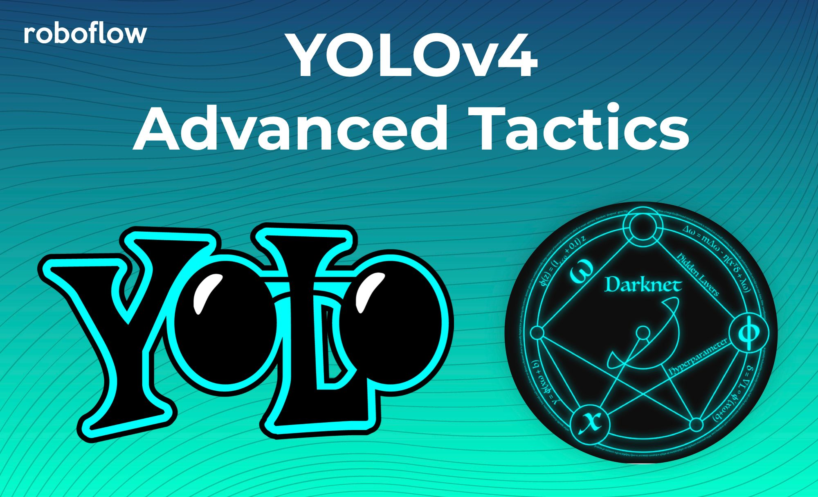
YOLO v4 Optimal Speed and Accuracy of Object Detection

Slide 2
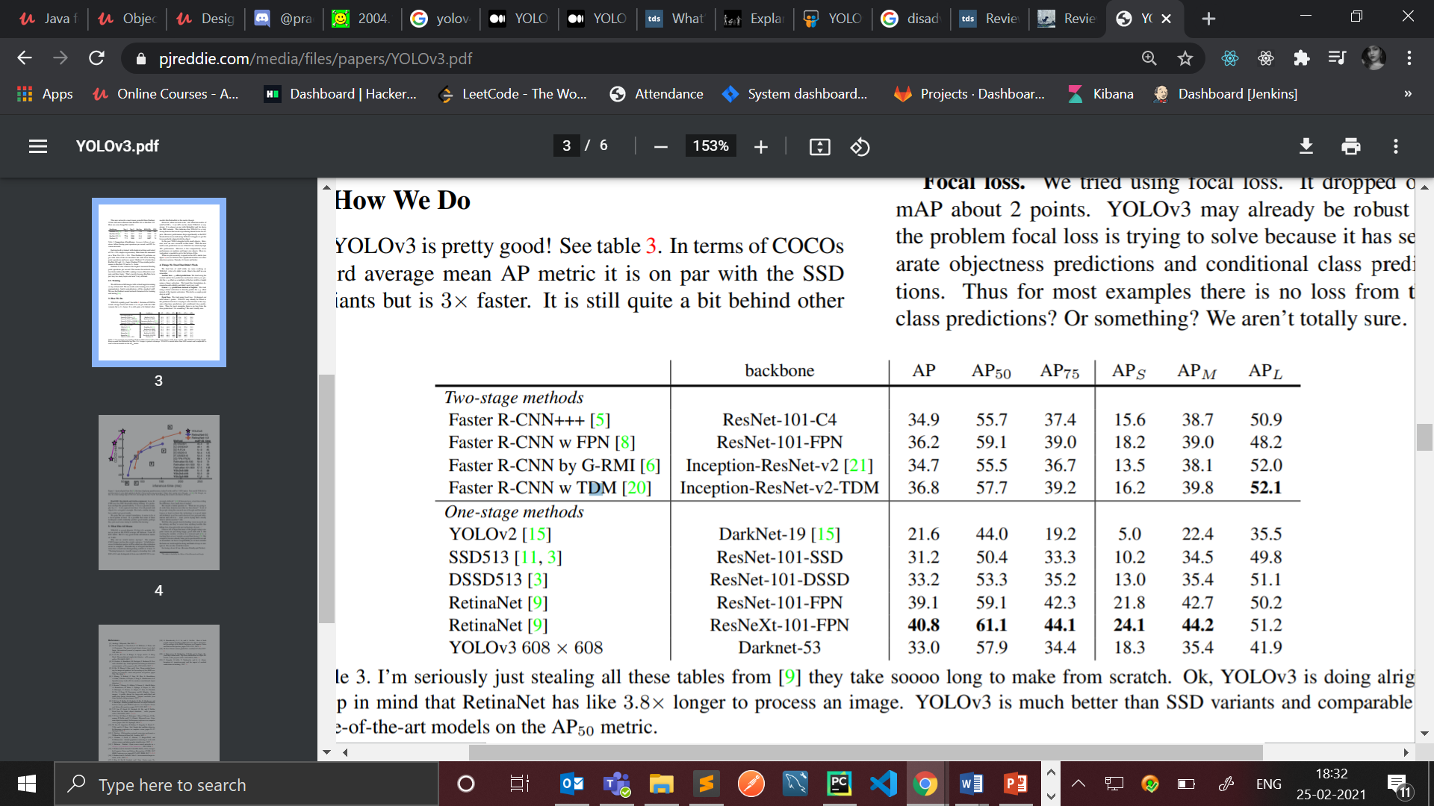
Limitations of YOLOv3?
YOLOv3 performance drops significantly as the IOU threshold increases indicating YOLOv3 struggles to get the boxes perfectly aligned with the object.
It’s not as great on the COCO average AP between .5 and .95 IOU metric. But it’s very good on the old detection metric of .5 IOU.
MAP score between 0.5 to 0.95 IOU can be increased.
The average precision for medium and large objects can be improved as medium is 5 percent and large is 10 percent behind the best. With the new multi-scale predictions we see YOLOv3 has relatively high APs performance.
However, it has comparatively worse performance on medium and larger size objects.

Slide 3
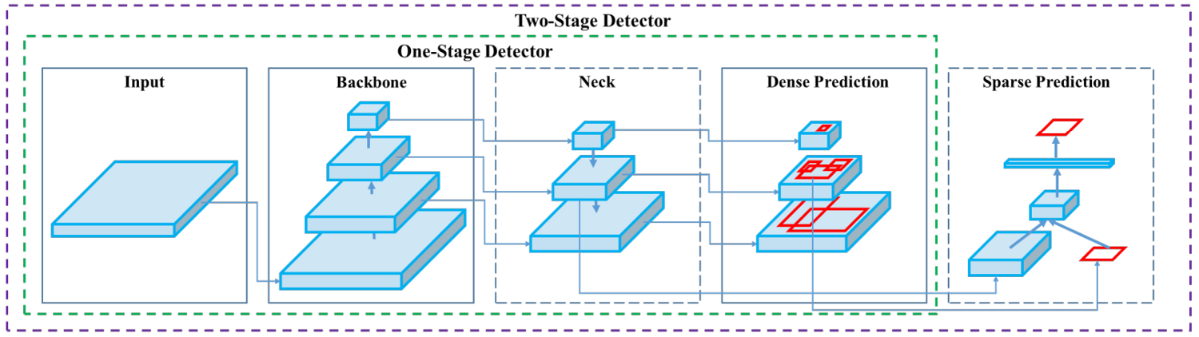
Modern Object Detection
A modern detector is usually composed of two parts, a backbone which is pre-trained on ImageNet and a head which is used to predict classes and bounding boxes of objects.
As to the head part, it is usually categorized into two kinds, i.e., one-stage object detector and two-stage object detector.
Object detectors developed in recent years often insert some layers between backbone and head, and these layers are usually used to collect feature maps from different stages. We can call it the neck of an object detector. Usually, a neck is composed of several bottom-up paths and several top-down paths.

Slide 4
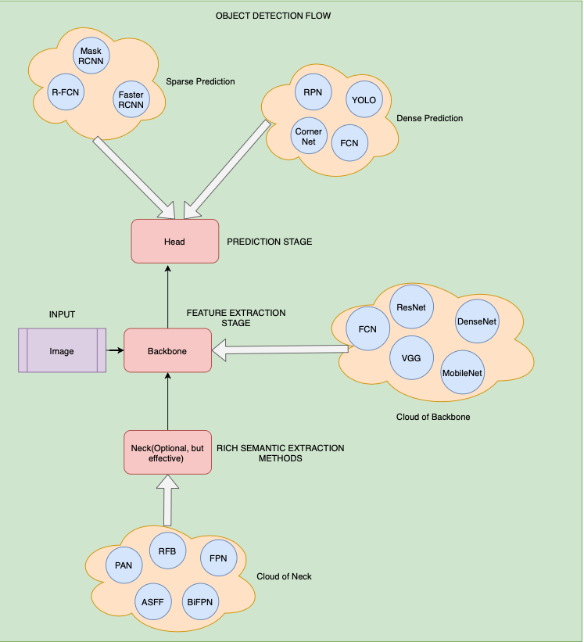
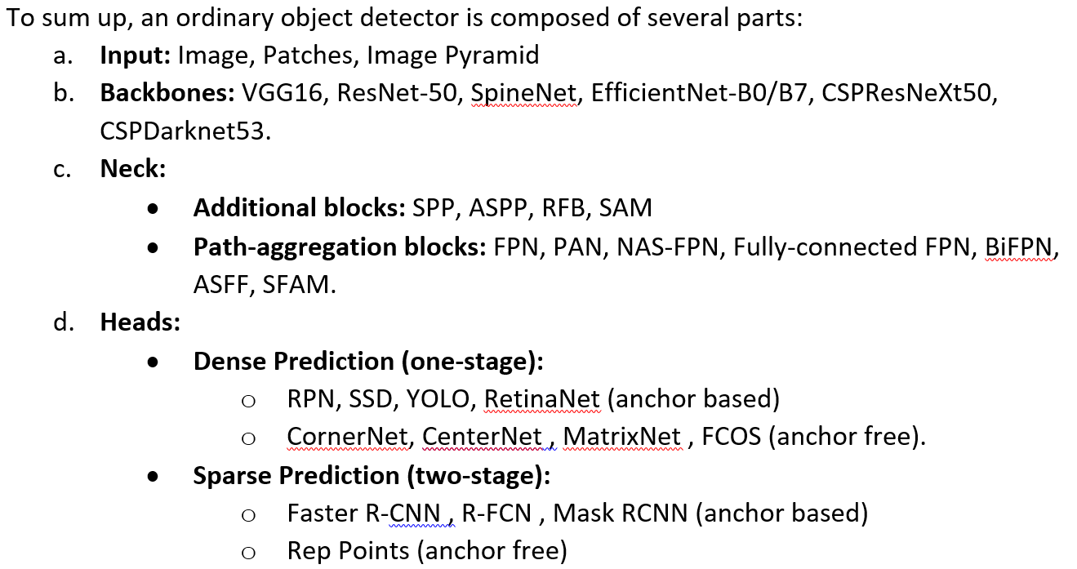
Object Detection Flow

Slide 5

Why YOLO v4?
YOLOv4 outruns the existing methods significantly in both terms “detection performance” and “superior speed”.
The main goal of this work is designing a fast operating speed of an object detector in production systems and optimization for parallel computations, rather than the low computation volume theoretical indicator (BFLOP). Thus it optimizes neural network detector for parallel computations”.
It verifies the influence of state-of-the-art Bag-of-Freebies and Bag-of-Specials methods of object detection during the detector training.
YoloV4 is an important improvement of YoloV3, the implementation of a new architecture in the Backbone and the modifications in the Neck have improved the mAP(mean Average Precision) by 10% and the number of FPS(Frame per Second) by 12%.
It proposes an efficient and powerful object detection model. It means everyone can use a 1080Ti or 2080Ti GPU to train a superfast and accurate object detector. It modifies the state-of-the-art methods and make them more efficient and suitable for single GPU training.

Slide 6
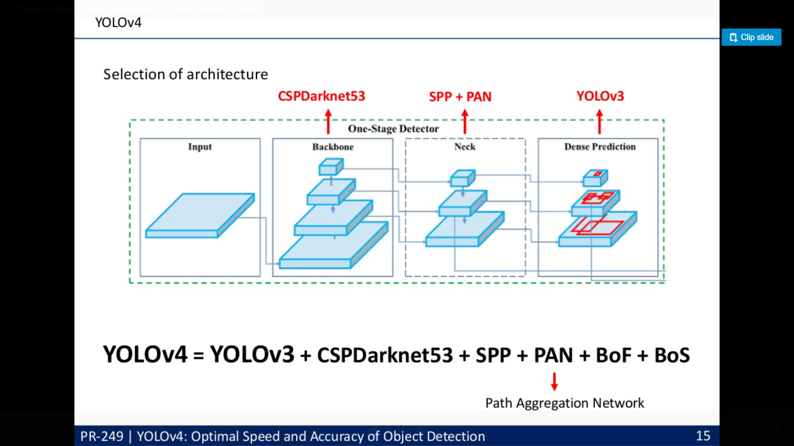
YOLO v4 Architecture:

Slide 7
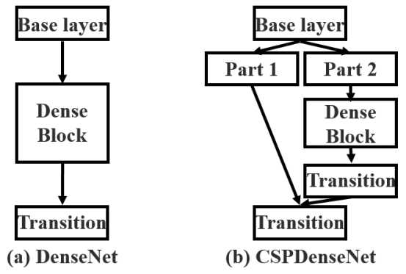
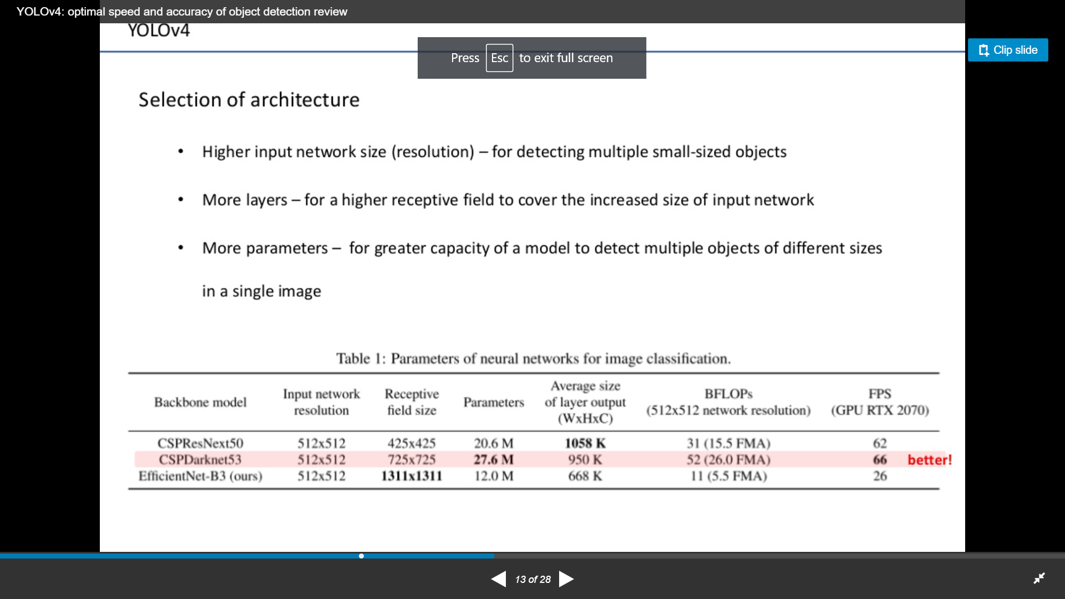
Backbone
Backbone here refers to the feature-extraction architecture. Backbone is one of the ways where we can improve accuracy, we can design a deeper network to extend the receptive field and to increase model complexity.
YOLOv3 has Darknet53 with 53 convolutional layers, so it’s more accurate but slower whereas YOLOv4 uses backbone which isn’t Darknet53 but CSPDarknet53. It’s based on DenseNet.
CSP stands for Cross-Stage-Partial connections. The idea here is to separate the input feature maps of the Dense Block into two parts, one that will go through a block of convolutions, and one that won’t. Then, we aggregate the results.

Slide 8
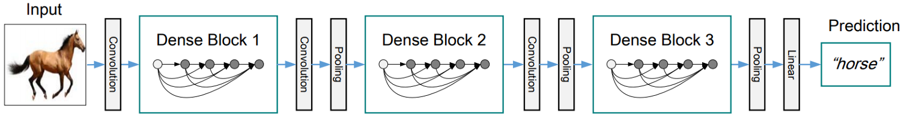
DenseNet
A Dense Block in the YOLOv4 backbone contains multiple convolution layers with each layer composed of batch normalization, ReLU, and followed by convolution.
Instead of using the output of the last layer only, each layer takes the output of all previous layers as well as the original as its input. Each layer outputs four feature maps. Therefore, at every layer, the amount of feature maps is magnified by four — the rate of growth.
A DenseNet can be formed by composing multiple Dense Blocks with a transition layer in between that composed of convolution and pooling.
DenseNet was designed to connect layers in convolutional neural networks with the following motivations: to alleviate the vanishing gradient problem, to bolster feature propagation, encourage the network to reuse features, and reduce the number of network parameters.

Slide 9
Neck
The essential role of the neck is to collect feature maps from different stages.
Usually, a neck is composed of several bottom-up paths and several top-down paths.
To enrich the information that enters the head, neighboring feature maps coming from the bottom-up and the top-down stream are combined together element-wise or concatenated before entering the head.
Neck is leveraged in backbones for the extraction of rich semantic features that are further used for accurate predictions.
After optimal testings, Spatial Pyramid Pooling(SPP) was tightly coupled with CSPDarknet53 which helped in the drastic increase of the receptive field and Modified Path Aggregation Networks for pyramidal structure instead of Feature Pyramid Networks used in YOLO4.

Slide 10
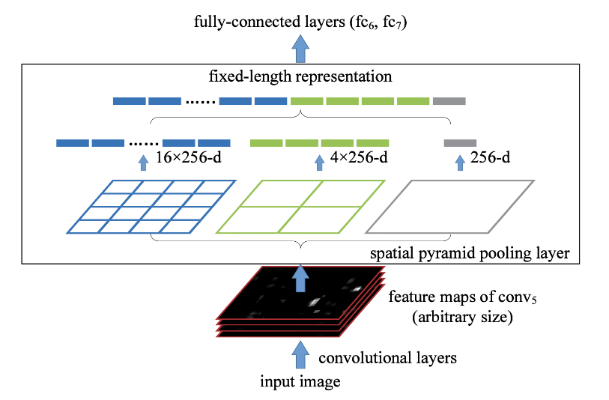
SPP
At the output of the convolution neural networks, we have the features map, these are features generated by our different filters.
To make it simple, we can have a filter able to detect circular geometric shapes, this filter will produce a feature map highlighting these shapes while keeping the location of the shape in the image.
Spatial Pyramid Pooling Layer will allow to generate fixed size features whatever the size of our feature maps.
SPP is able to generate a fixed- length output regardless of the input size
SPP uses multi-level spatial bins, while the sliding window pooling uses only a single window size. Multi-level pooling has been shown to be robust to object deformations
SPP can pool features extracted at variable scales thanks to the flexibility of input scales.

Slide 11
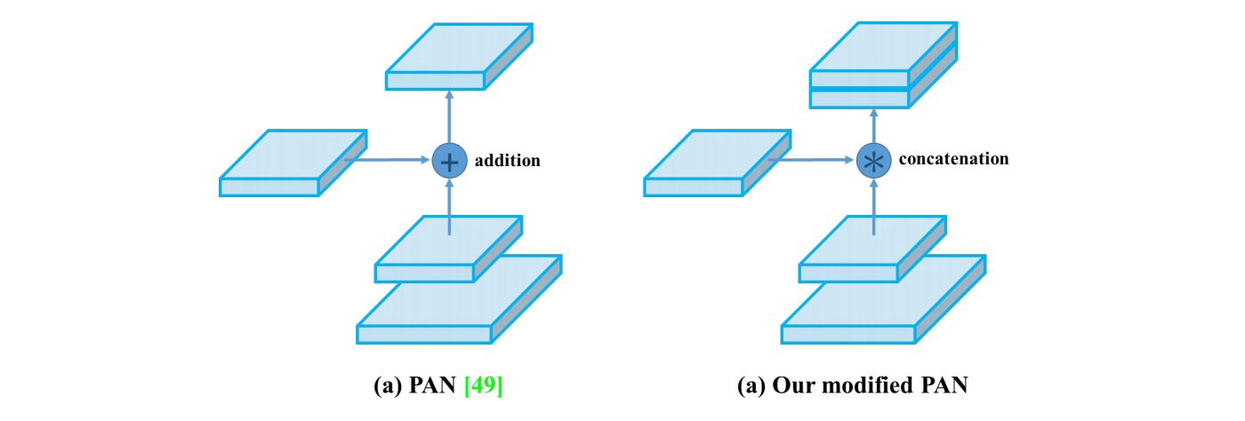
PaNet
PaNet has introduced an architecture that allows better propagation of layer information from bottom to top or top to bottom.
In the original implementation of PaNet, the current layer and information from a previous layer is added together to form a new vector.
In the YoloV4 implementation, a modified version is used where the new vector is created by concatenating the input and the vector from a previous layer.

Slide 12
Head
Head is the detector stage of the network.
The role of the head in the case of a one stage detector is to perform dense prediction.
Here, we have the same process as in YOLOv3. The network detects the bounding box coordinates (X, Y, W, H) together with the confidence score for a class.
The dense prediction is the final prediction which is composed of a vector containing the coordinates of the predicted bounding box (center, height, width), the confidence score of the prediction and the label.
The goal of YOLO is to divide the image into a grid of multiple cells and then for each cell to predict the probability of having an object using anchor boxes.
The output is a vector with bounding box coordinates and probability classes. Also in the end there is used post-processing techniques such as non-maxima suppression.

Slide 13
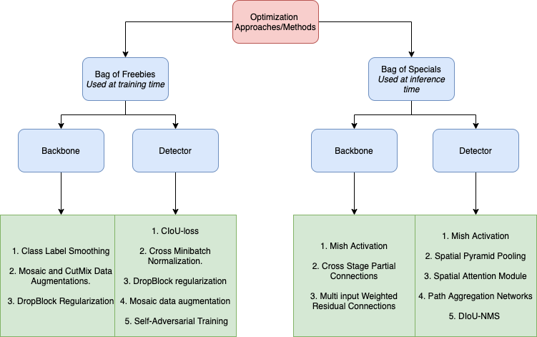
Optimization Approaches
YOLOv4 introduces two new “Bags” or optimization procedures to be used at the time of training and inference.
These are stated as Bag of Freebies(BoG) and Bag of Specials(BoS).

Slide 14
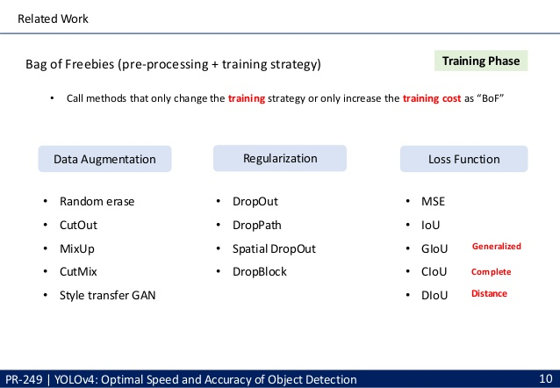
Bag of Freebies
Training Phase: Pre-processing + Training Strategy
Methods that only change the training strategy or only increase the training cost are called “bag of freebies.”
What is often adopted by object detection methods and meets the definition of bag of freebies is data augmentation, regularization, Loss Function.

Slide 15
Data Augmentation
The purpose of data augmentation is to increase the variability of the input images, so that the designed object detection model has higher robustness to the images obtained from different environments.
The most commonly used methods are Photometric Distortion, Geometric Distortion, MixUp, CutMix and GANs.
In dealing with photometric distortion, we adjust the brightness, contrast, hue, saturation, and noise of an image.
For geometric distortion, we add random scaling, cropping, flipping, and rotating.
Mixup augmentation forms a new image through weighted linear interpolation of two existing images. Mixup reduces the memorization of corrupt labels, increases the robustness to adversarial examples, and stabilizes the training of generative adversarial networks.
CutMix augmentation patches are cut and pasted among training images where the ground truth labels are also mixed proportionally to the area of the patches. CutMix improves the model robustness against input corruptions and its out-of-distribution detection performances.
Mosaic is a data augmentation method that combines 4 training images into one for training (instead of 2 in CutMix). This enhances the detection of objects outside their normal context. In addition, each mini-batch contains a large variant of image (4×) and therefore, reduces the need for large mini-batch sizes in estimating the mean and the variance.

Slide 16
Regularization
Regularization technique is used for reducing overfitting in neural networks by preventing complex co-adaptations on training data.
It is a very efficient way of performing model averaging with neural networks.
A simple and powerful regularization technique for neural networks and deep learning models is dropout.
The term "dropout" refers to dropping out units (both hidden and visible) in a neural network.
As a neural network learns, neuron weights settle into their context within the network. Weights of neurons are tuned for specific features providing some specialization. Neighboring neurons become to rely on this specialization, which if taken too far can result in a fragile model too specialized to the training data. This reliant on context for a neuron during training is referred to complex co-adaptations.

Slide 17
Loss Function
A loss function gives us signals on how to adjust weights to reduce cost. So in situations where we make wrong predictions, we expect it to give us direction on where to move.
The traditional object detector usually uses Mean Square Error (MSE) to directly perform regression on the center point coordinates and height and width of the BBox.
When IoU is used and the ground truth box and the prediction do not overlap. The IoU loss function cannot tell which one is better even one may be closer to the ground truth than the other.
Generalized IoU (GIoU) fixes this by refining the loss as but this loss function tends to expand the prediction boundary box first until it is overlapped with the ground truth. Then it shrinks to increase IoU.
Distance IoU (DIoU) introduces a new goal to reduce the central points separation between the two boxes.
We use Complete IoU (CIoU) loss for better convergence on a bounding box regression by increasing the overlapping area of the ground truth box and the predicted box, minimize their central point distance, and maintain the consistency of the boxes’ aspect ratio.

Slide 18
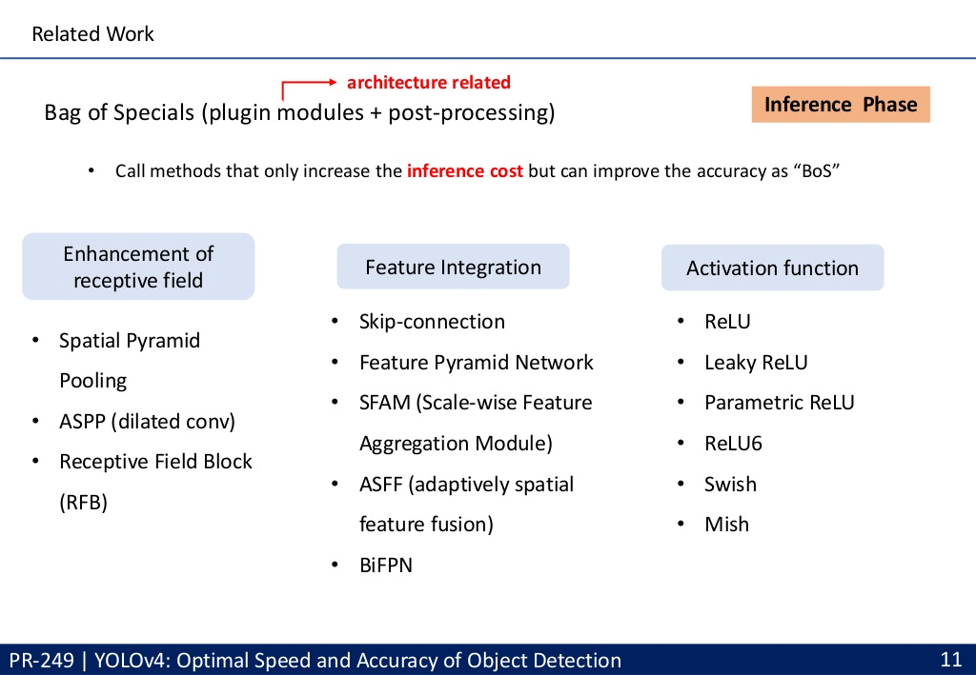
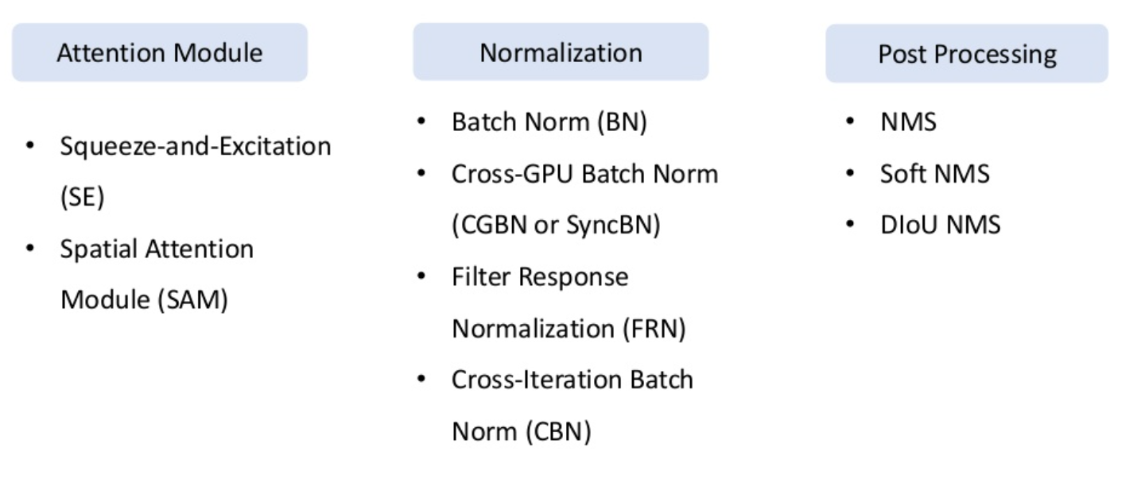
Bag of Specials
Training Phase: Pre-processing + Training Strategy
Methods that only increase the inference cost but can improve the accuracy are called “bag of specials.”
It consists of plugin modules and post-processing methods that only increase the inference cost by a small amount but can significantly improve the accuracy of object detection
Plugin modules are the list of attributes or algorithms to increase the receptive field, strengthening feature integration capability, etc. whereas post-processing modules are used to filter out detections predicted by a detector.

Slide 19
Enhancement of Receptive Field
Common modules that can be used to enhance receptive field are SPP, ASPP, and RFB to separate out the most important features.
Pooling layer removes the fixed-size constraint of the network, i.e. a CNN does not require a fixed-size input image. Specifically, we add an SPP layer on top of the last convolutional layer.
The SPP layer pools the features and generates fixed-length outputs, which are then fed into the fully-connected layers (or other classifiers).
In other words, we perform some information aggregation at a deeper stage of the network hierarchy (between convolutional layers and fully-connected layers) to avoid the need for cropping or warping at the beginning.

Slide 20
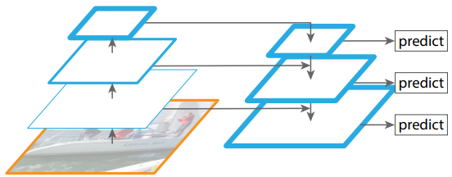
Feature Integration
Processing multiple scale images is time consuming and the memory demand is too high to be trained end-to-end simultaneously. Hence, we may only use it in inference to push accuracy as high as possible, when speed is not a concern.
It combines low-resolution, semantically strong features with high-resolution, semantically weak features via a top-down pathway and lateral connections.
This feature pyramid that has rich semantics at all levels and is built quickly from a single input image scale, thereby without sacrificing representational power, speed, or memory.
These pyramids are scale-invariant in the sense that an object’s scale change is offset by shifting its level in the pyramid. Intuitively, this property enables a model to detect objects across a large range of scales by scanning the model over both positions and pyramid levels.

Slide 21
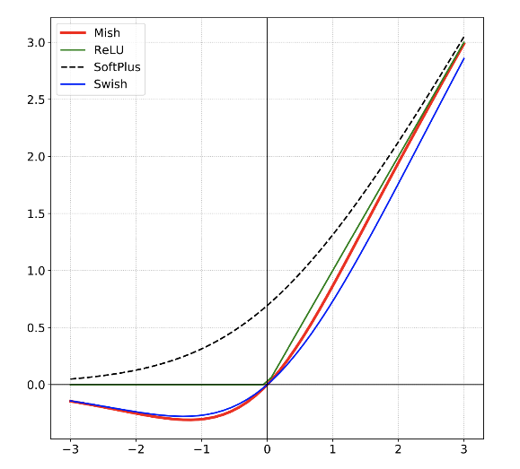
Activation Function
The activation function is a non-linear transformation that we do over the input before sending it to the next layer of neurons or finalizing it as output.
YOLOv4 uses Mish Activation Function. Mish is a novel self-regularized non-monotic activation function which can be defined by f(x) = x tanh(softplus(x)).
Mish is bounded below and unbounded above.
Mish properties helps in better expressivity and information flow. Being unbounded above, Mish avoids saturation, which generally causes training to slow down due to near-zero gradients drastically. Being bounded below is also advantageous since it results in strong regularization effects.

Slide 22
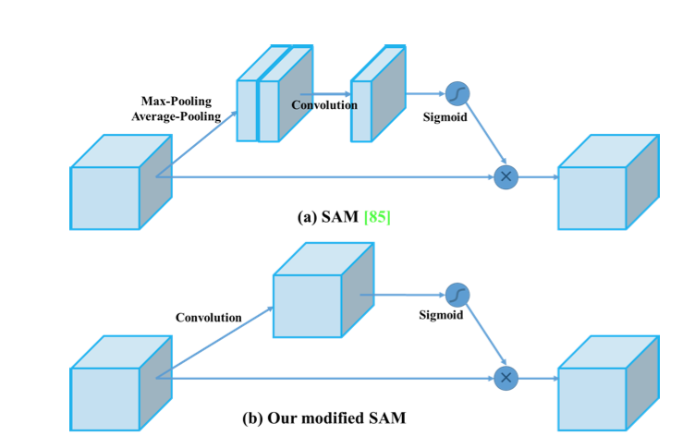
Attention Module
The attention module that is often used in object detection is mainly divided into channel-wise attention and pointwise attention, and the representatives of these two attention models are Squeeze-and-Excitation (SE) and Spatial Attention Module (SAM), respectively.
In the case of Yolo the attentions are used to highlight the most important features created by the convolution layers and remove the unimportant ones.
SAM simply consists of applying two separate transforms to the output feature map of a convolutional layer, a Max Pooling and an Avg Pooling. The two features are concatenated and then passed in a convoluted layer, before applying a sigmoid function that will highlight where the most important features are located. Although YOLOv4 uses modified SAM.

Slide 23
Normalization
Batch Normalization is a technique that mitigates the effect of unstable gradients within deep neural networks.
BN introduces an additional layer to the neural network that performs operations on the inputs from the previous layer.
The operation standardizes and normalizes the input values. The input values are then transformed through scaling and shifting operations.
YOLOv4 uses Cross mini Batch Normalization.
Batch Normalization does not perform when the batch size becomes small. The estimate of the standard deviation and mean is biased by the sample size. The smaller the sample size, the more likely it is not to represent the completeness of the distribution.
To solve this problem, Cross mini Batch Normalization is used, which uses estimates from recent batches to improve the quality of each batch’s estimate.

Slide 24
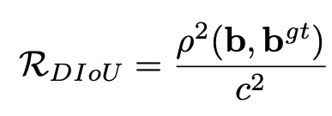
Post-processing
For post-processing we have to select the best bounding box, from the multiple predicted bounding boxes, these object detection algorithms use non-max suppression.
NMS (Non-Maximum Suppression) is used to remove the boxes that represent the same object while keeping the one that is the most precise compared to the real bounding box.
It uses DIoU-NMS to test if the overlap rate minus the distance between the two centers is lower than the threshold, if this is the case we keep the bounding box, otherwise we delete it.
Below is the equation where where b and bgt denote the central points of B and Bgt, ρ(·) is the Euclidean distance, and c is the diagonal length of the smallest enclosing box covering the two boxes.

